Slide 1
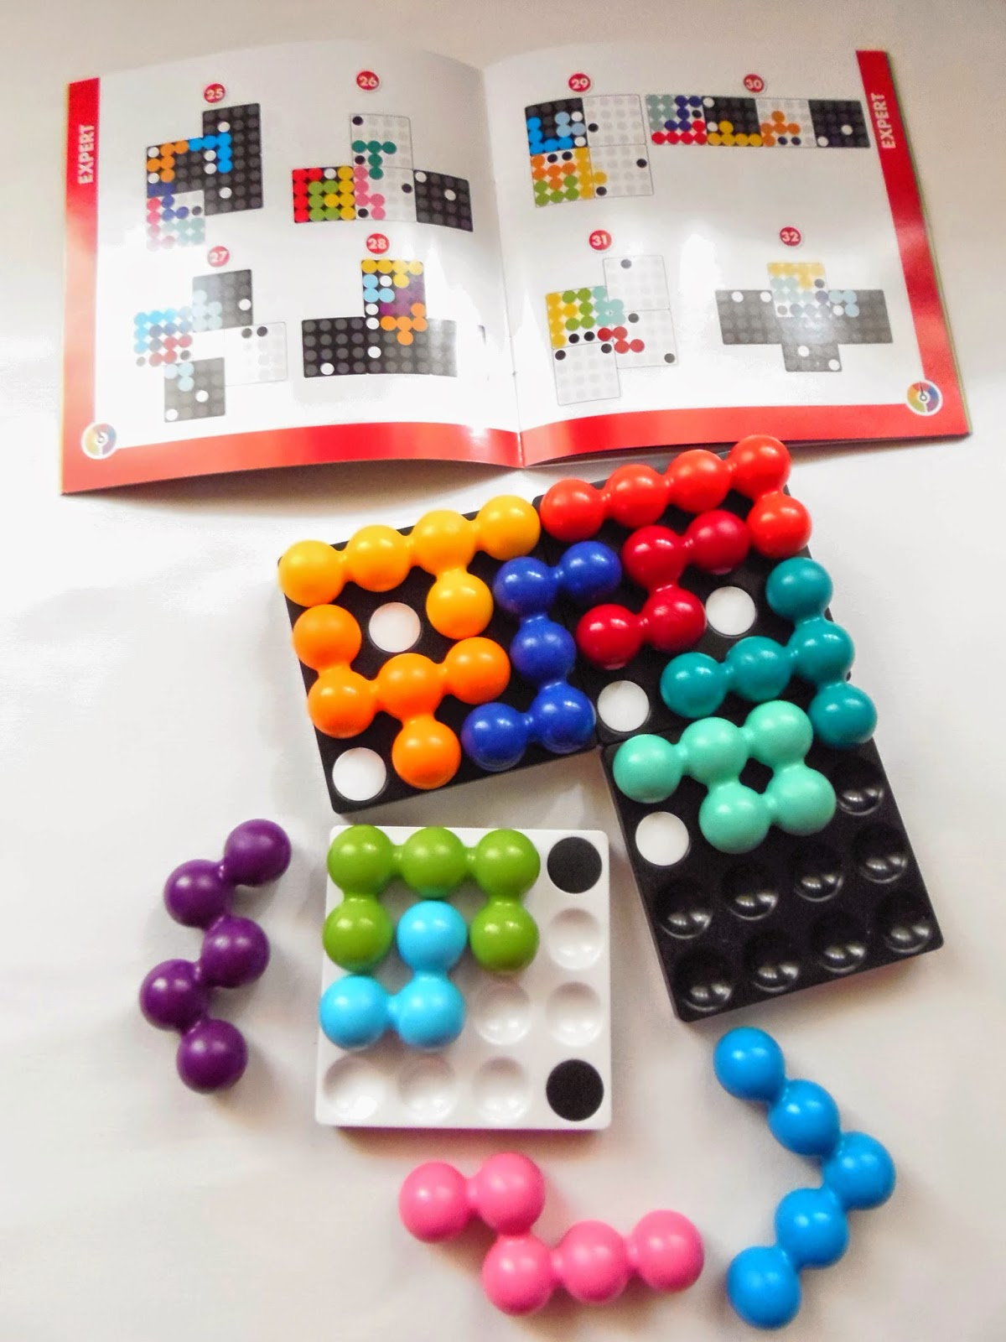
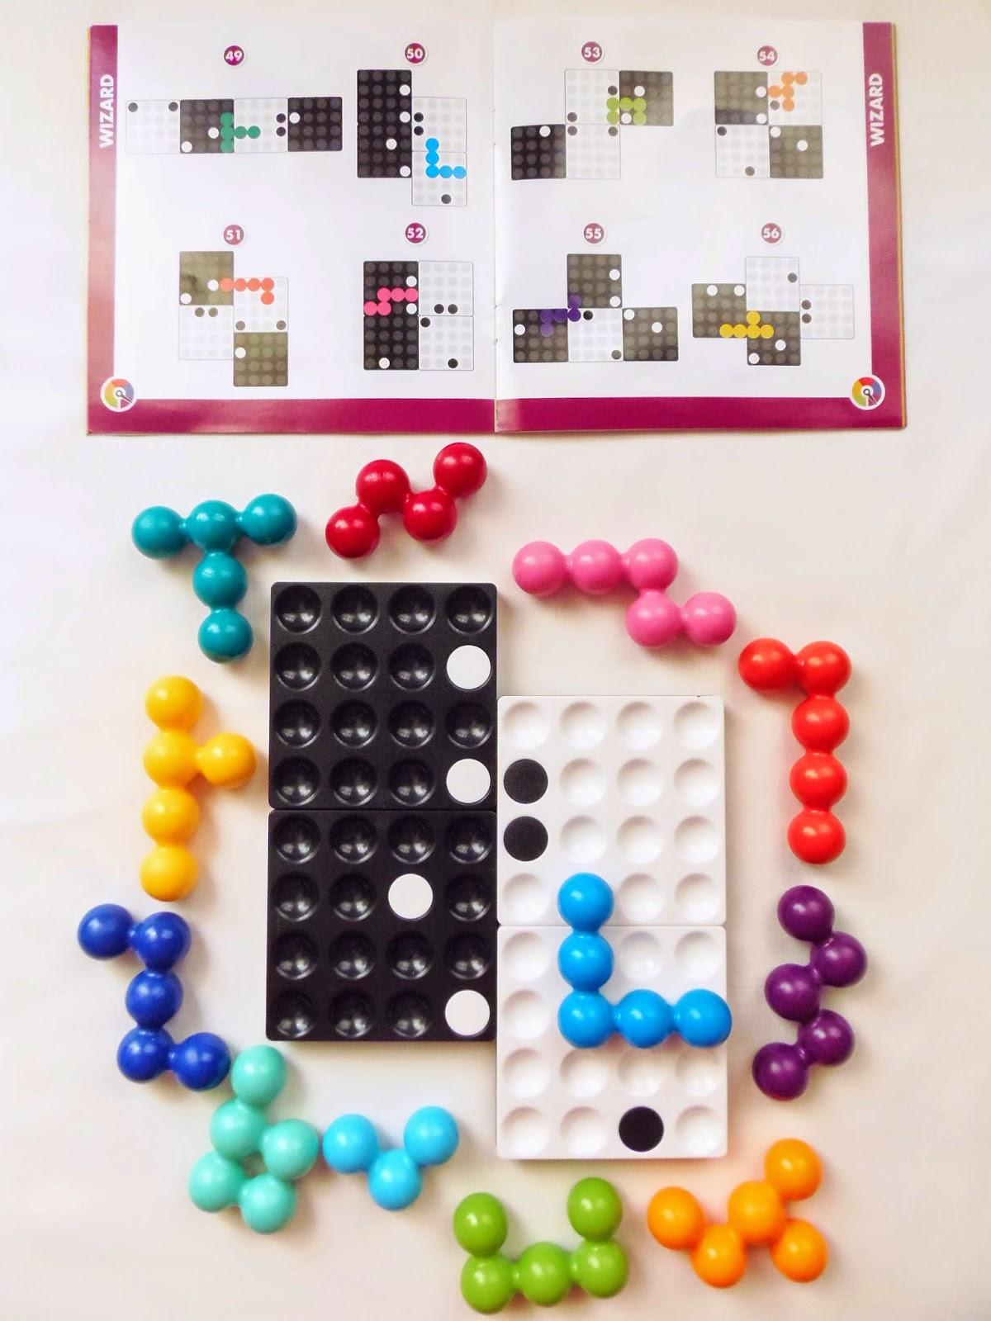

-MY LITTLE- -QUADRILLION-

Slide 2
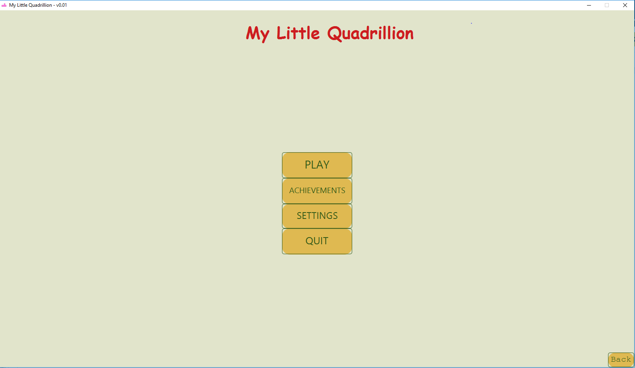
OUTLINE
- HOW TO PLAY
- DESCRIPTION
- INNOVATIONS
- DYNAMIC MODELS
- SUBSYSTEM DECOMPOSITION
- DESIGN TRADEOFFS

Slide 3

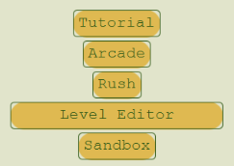
Description
My Little Quadrillion is a digital, single-player, puzzle, board game. The game is inspired by the physical board game called Quadrillion by Smart Games. The game has 4 modes: Arcade Mode, Rush Mode, Level Editor, and Sand Box.

Slide 4
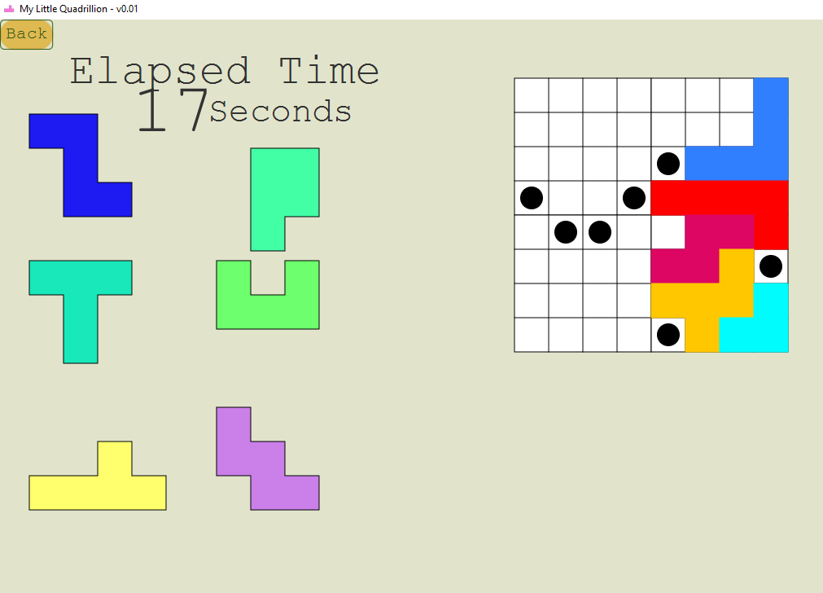
How To Play
GOAL The purpose of the game is to fill up the board with provided pieces.
DRAG To drag a piece hover your mouse over it and left click and drag the mouse without releasing the left button until the piece is over the intended position.
ROTATE To rotate the piece click the mouse right button while dragging the piece.
FLIP To flip the piece symmetrically over its vertical axis keep rotating, the piece will flip in at most 4 rotations depending on the geometry of the piece.
PLACE To place a piece on the board, release the left button of the mouse over the intended position. If the closest place on the board is available on the game board, the piece will snap on the board and change color saturation to visually confirm that the piece is placed.

Slide 5
INNOVATIVE FEATURES

Slide 6
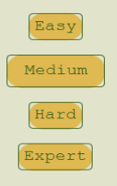
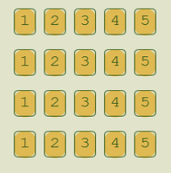
Arcade Mode
There are many levels that can be played.
Players get stars according to number of moves and time elapsed.
Completing easier difficulties unlocks harder difficulties.

Slide 7
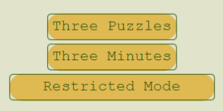
Rush Mode
There are 3 challenges.
Players get scores according to different criterion.
Players compete on leader board for each mode.

Slide 8
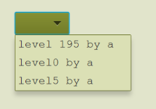

Level Editor
Players can create their own levels.
Players can play other players’ levels.

Slide 9
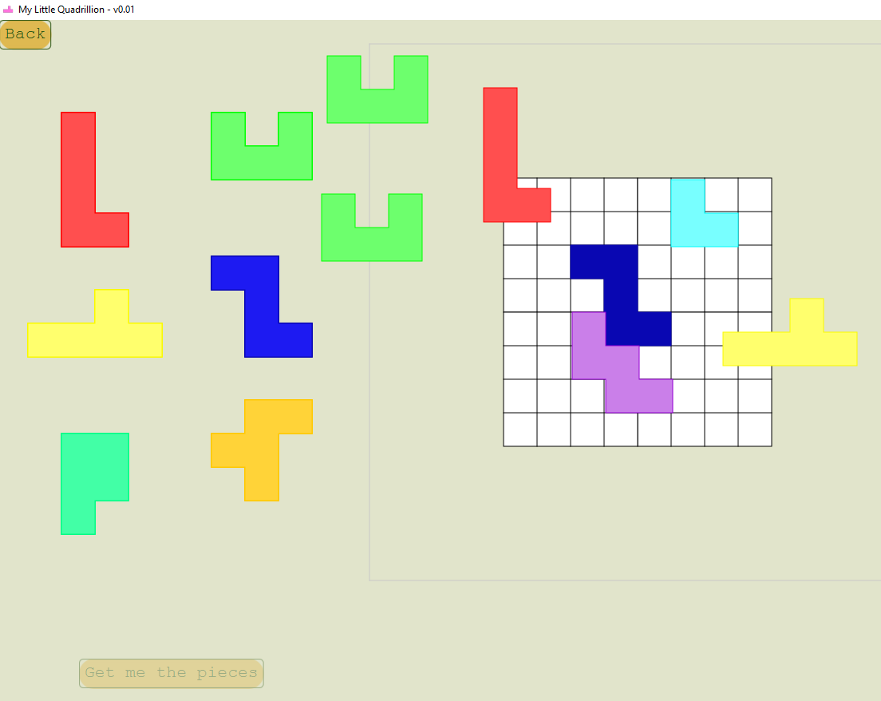
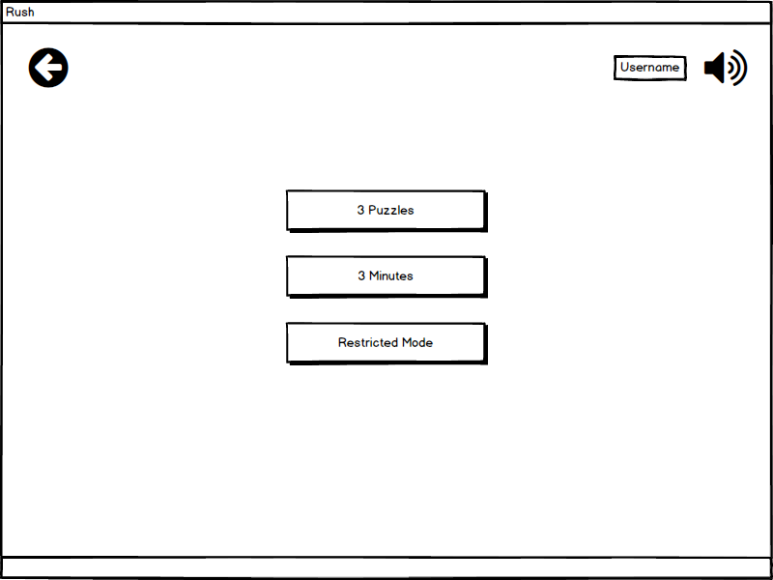
Sand Box
Users can place as many grids and pieces as they want.
No rules or goals.

Slide 10
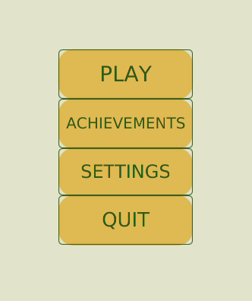
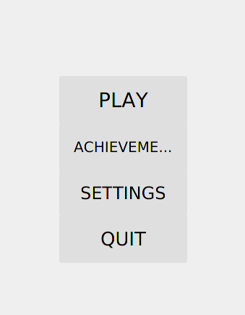
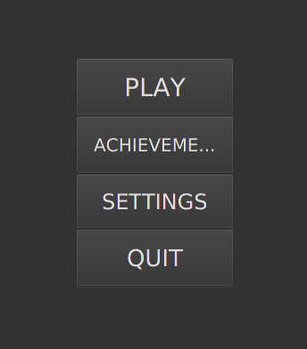
Different Themes / Night Mode

Slide 11
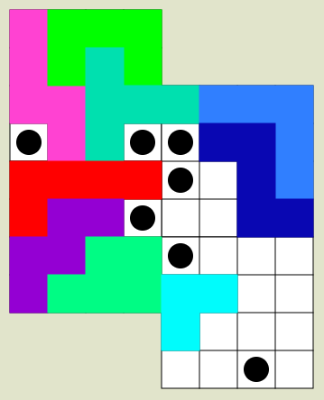
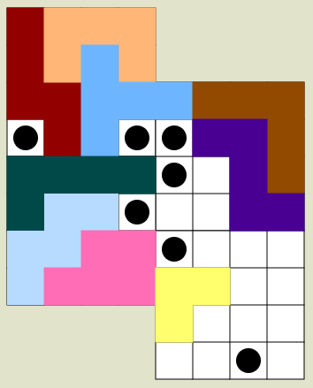
Color Blind Mode

Slide 12
Database
User, achievements, progress relations are stored in the database.
MySQL
Dijkstra Server
JDBC Driver

Slide 13
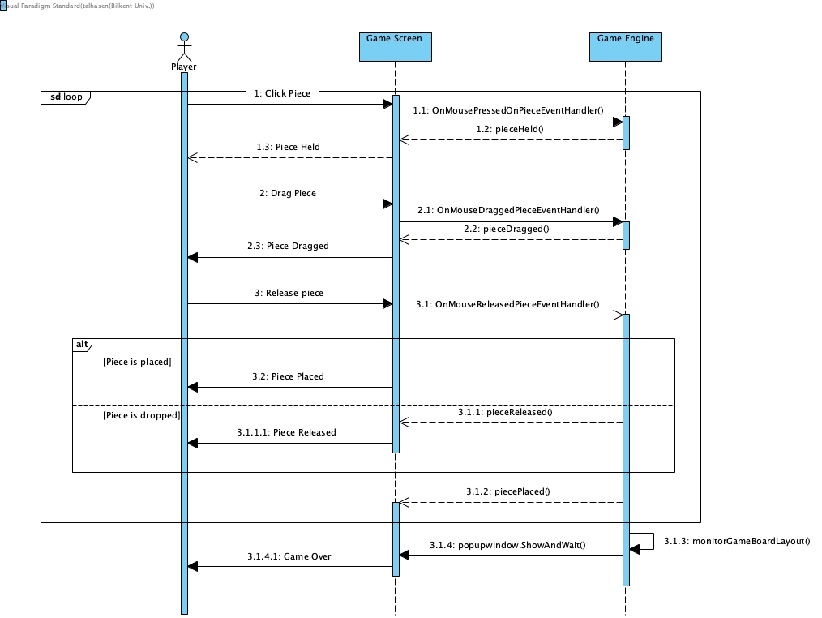
Sequence Diagram of Game Core

Slide 14
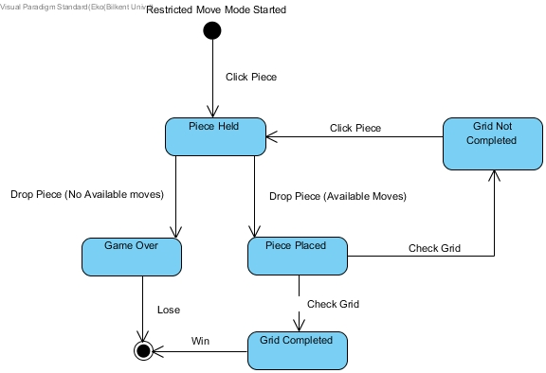
State Diagram (Restricted Move)

Slide 15
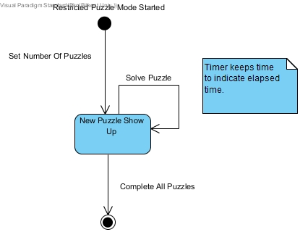
State Diagram (Restricted Puzzle)

Slide 16
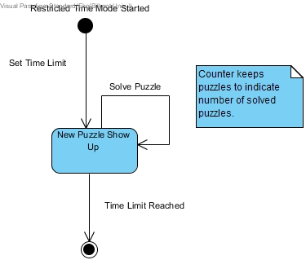
State Diagram (Restricted Time)

Slide 17
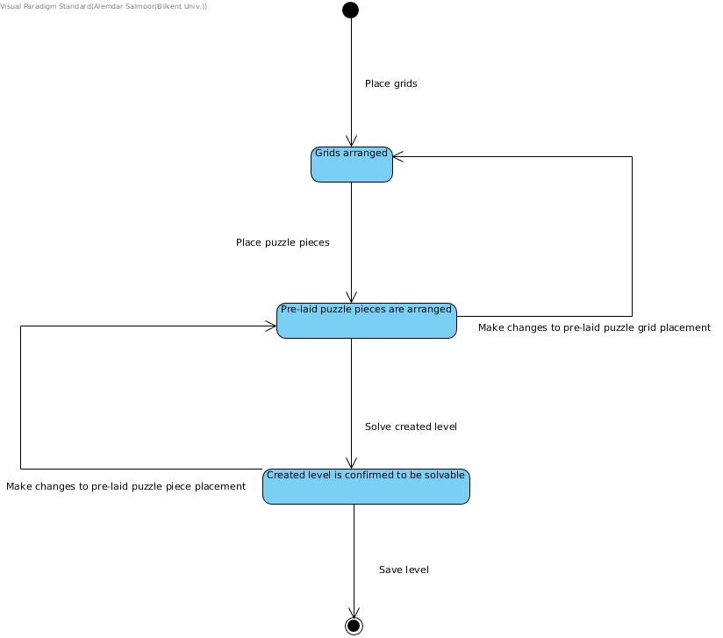
Level Editor

Slide 18
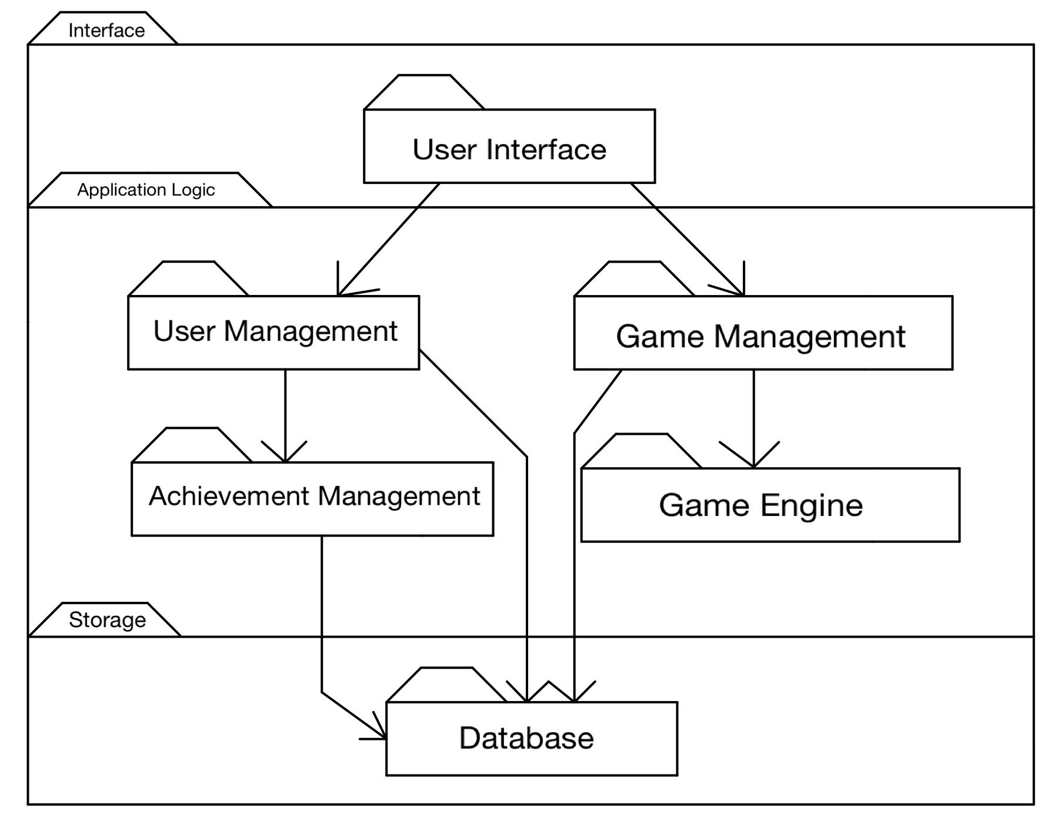
Subsystem Decomposition

Slide 19
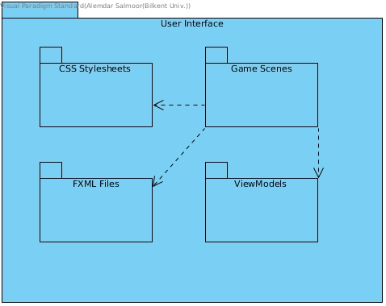
User Interface

Slide 20
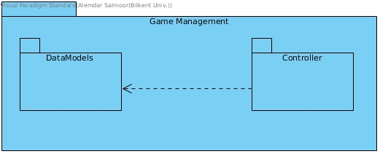
Game Management

Slide 21
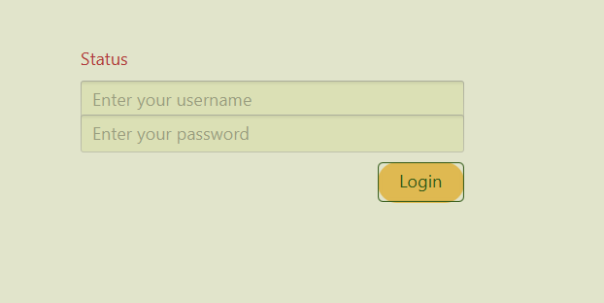
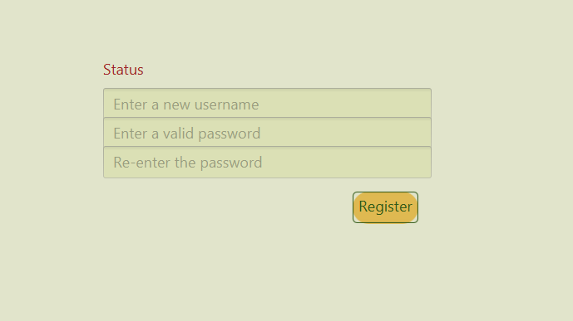
Design Tradeoffs
For better user experience, security is forsaken.
Detailed personal information do not required
There are no strict password rules

Slide 22
Limited Functionality for rapid development.
One semester to develop a game
Efficiency is decreased for Portability.
Java SDK is required for all Operating Systems
Response time is forsaken for Memory Space.
The game is not time critical

